Slide 1
Tutorial 04 Fundamentals of Artificial Intelligence
Hualie Jiang

Slide 2
Problem 1
1. Answer the following questions:
(a) In CSPs, what are the definitions of: 1) a consistent assignment; 2) a complete assignment; 3) a solution? (L5: P7)
(b) In CSPs, what is the meaning of nodes and arcs? (L5: P10)
(c) What is backtracking search? What kind of search method does it belong to? (L5: P19)
(d) What general-purpose heuristics can be used in CSPs?. (P5: P20)

Slide 3
Definitions about CSPs
A consistent assignment
The combination of values does not violate any constraint Ci
A complete assignment
an assignment where all variables are assigned values
A solution to a CSP is
a complete & consistent assignment
For optimization, objective function may be used to find out optimal solution.

Slide 4
Nodes and Arcs
N: Nodes of the graph
the set of variables
A: Arcs of the graph
the set of constraints

Slide 5
Backtracking Search
Backtracking search is used for a depth-first search that chooses values for one variable at a time and backtracks when a variable has no legal values left to assign. It is a form of depth-first search, is commonly used for solving CSPs. (Artificial Intelligence: A modern approach, 3rd edition)

Slide 6
General-Purpose Heuristics
General-purpose methods can give huge gains in speed:
Which variable should be assigned next?
Variable ordering
In what order should its values be tried?
value ordering
Can we detect inevitable failure early?
forward checking
Can we take advantage of problem structure?
mini-conflicts

Slide 7
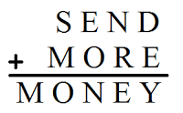
Problem 2
2. The letters in the following cryptarithmetic puzzle are one-digit integers and each has a different value. What are the variables, domains and constraints of this problem? (L5: P16-17)

Slide 8
Cryptarithmetic Puzzle
Variables: D,E,M,N,O,R,S,Y, X1,X2,X3,X4
Domain: {0,1,2,3,4,5,6,7,8,9}, {0,1} for Xi
Constraints:
Alldiff{ D,E,M,N,O,R,S,Y }
D+E = 10*X1+Y
X1+N+R = 10*X2+E
X2+E+O = 10*X3+N
X3+S+M = 10*X4+O
X4 = M

Slide 9
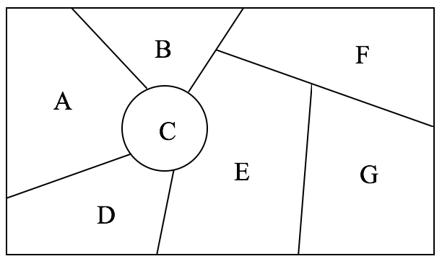
Problem 3
3. In CSP problems, heuristics related to variable and value ordering can be used. Given the following map coloring problem with four colors {red, green, blue, yellow}. Answer the following questions. (a) If the degree heuristic is used, which variable should be chosen first? (b) If we choose A as the first variable and B as the second variable, which should we choose as the third variable applying the minimum- remaining-values (MRV) heuristic? (c) If we choose A with red, choose B with green, and choose E as the third variable, what color should we assign to E applying the least-constraining values heuristic? (L5: P22-26)

Slide 10
Degree Heuristic
Degree heuristic (first variable selection)
selects the variable with maximum number of constraints on other unassigned variables
E (5 degrees)

Slide 11
Minimum-Remaining-Values
MRV (Minimum remaining value) heuristic
called Most Constrained Variable
C (there are 2 values left for C)

Slide 12
Least-Constraining Values
Least-constraining values: Effective in some cases only
It prefers value that removes as few as possible the choices for the neighboring variables in the constraint graph
red

Slide 13
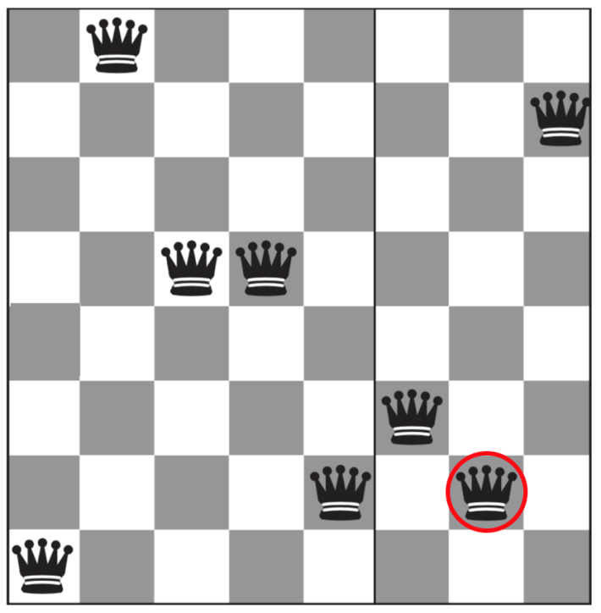
Problem 4
4. Use local search with mini-conflicts heuristic to solve the 8-queens problem. The queen in the red circle (7th row, 7th column) is chosen as the conflicted variable. Where should it move to? (L5: P36)

Slide 14
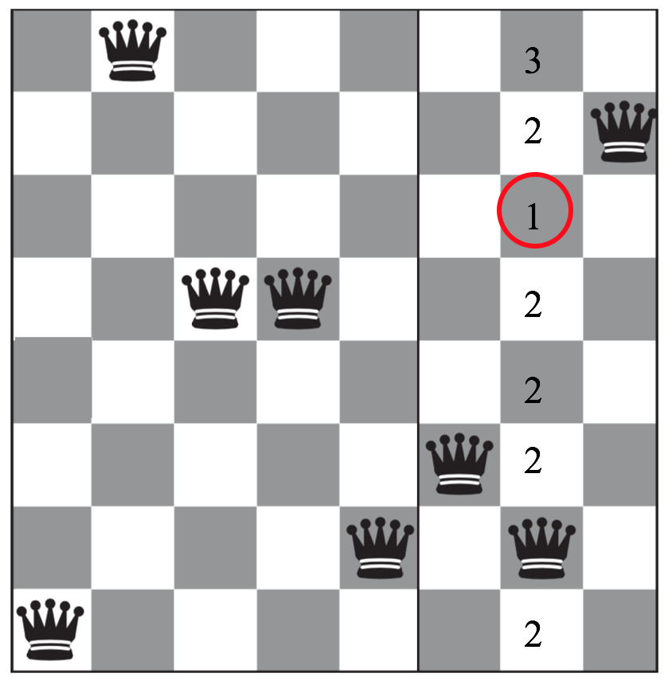
mini-conflicts heuristic
It should move to 3rd row and 7th colomn.

Slide 15
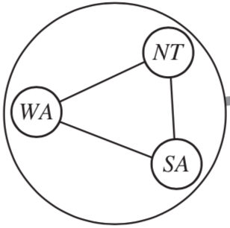
Problem 5
5. In the map coloring problem with three colors {red, green, blue}, if the three nodes WA, NT and SA as in the following figure are combined to a mega-variable {WA, NT, SA}, what is the domain of this mega-variable? (L5: P44)

Slide 16
Combining Nodes
{{r,g,b},{r,b,g},{g,r,b},{g,b,r},{b,r,g},{b,g,r}}

Slide 17
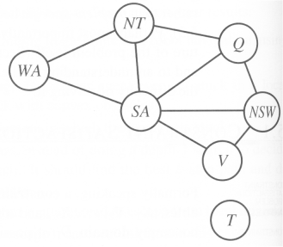
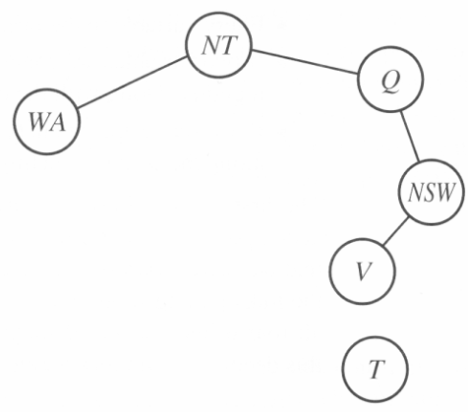
Problem 6
6. In Lecture 5, we understand that the simplest case for CSP is to reduce the constraint graph into a tree. One method is to assign some values for some variables, so that the remaining variables form a tree. As an example in the following, we could delete SA=red, then how to assign the remaining nodes? (L5: P41)

Slide 18
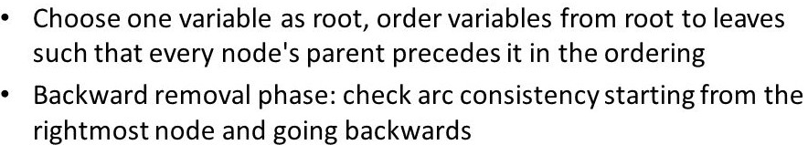
Problem 6

